Slide 1
Challenges and Opportunities in Translational ‘-omics’ Research
David F. Ransohoff MD
Departments of Medicine and Epidemiology
Director, K30 Clinical Research Curriculum
University of North Carolina at Chapel Hill

Slide 2
At end: Your experiences/challenges
Do you have:
-experiences/lessons, to help others
-challenges/problems, that others can help solve
Brief lessons/problems... or long ones... are welcome!

Slide 3
Challenges and Opportunities in Translational ‘-omics’ Research
Challenges
A challenge of ‘translational research’- that uses lab/basic methods and clinical epidemiology (especially observational epidemiology) methods: culture clash.
Opportunities
People trained in both methods can manage clash.
Example today
Proteomics for cancer diagnosis - Lessons from the last 10 years. (presented 2 wks ago in Cambridge UK, at Wellcome Trust)

Slide 4
Disclaimers
For audience inexperienced in clinical research methods:
some material abbreviated; may be insufficient
For audience experienced in clinical research methods:
some material elementary; you may already know
For all
•Ideas are not new.
•Problem in 2010:
- is not lack of new ideas
- is how to apply ideas we know.
One barrier: ‘culture clash’ at interface of basic
(laboratory) and clinical research

Slide 5
Clinical proteomics: Lessons
a. Problem
b. Causes
c. Lessons

Slide 6
Problem: Big Claims, Little Product
Claims (high degree of diagnostic discrimination of cancer vs not*) are not supported by subsequent research.
In 2010, do we even have “proof of principle”?
*Is there a there there?

Slide 7
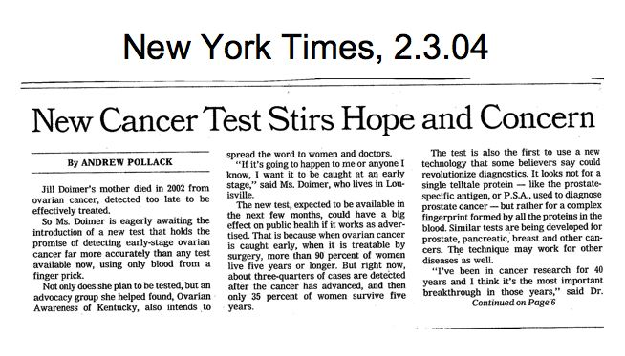

Slide 8
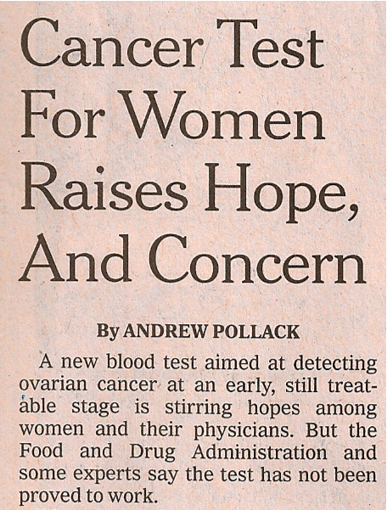
New York Times, 8.26.08

Slide 9
Problem: Big claims, little product
Asking for the impossible?
I do not understand the surge of activity in the search for biomarkers. The available evidence suggests that proteomics, despite almost a billion dollars investment, has so far failed to deliver any new biomarkers or commensurate returns. Many flagship companies have failed. More worrying, flawed studies, poor business models and exaggerated expectation will take time to reverse.
Walter Blackstock
University of Sheffield
(at Royal Society of Chemistry; London 2006)

Slide 10
Problem: Big claims, little product
from L Anderson; Plasma Proteome Inst.

Slide 11
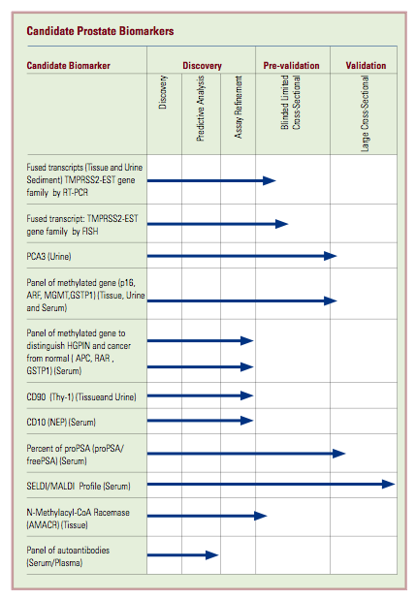
Products: EDRN program of discovery: Prostate Cancer
(NCI’s Early Detection Research Network - EDRN)
One assay reached ‘validation’ phase.

Slide 12
Products: EDRN program of discovery: Prostate Cancer
(NCI’s Early Detection Research Network - EDRN)
One assay reached ‘validation’ phase,
but assay wasn’t valid.

Slide 13
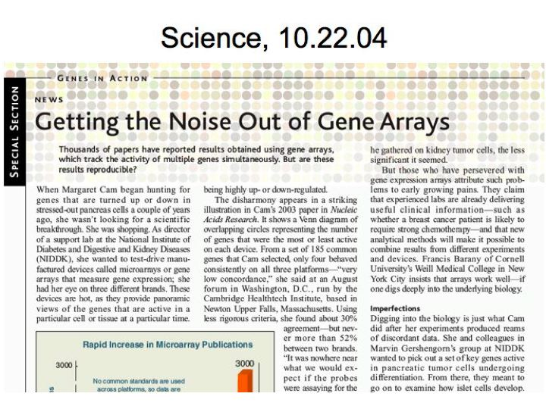
Similar problems: RNA expression genomics for Ca prognosis

Slide 14
Clinical proteomics: Lessons
a. Problem
b. Causes
c. Lessons

Slide 15
Problems in Biomarker Discovery
1. ‘Disconnect’ – big claims, little products
2. Reasons for disconnect
a) fundamental principles of science - neglected
b) research design - specific problems
1) chance
2) bias
3. How to address
•role of specimens
•other topics

Slide 16
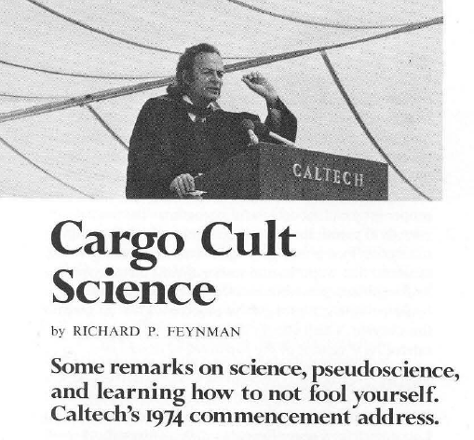
Principles of science
Feynman. Engineering and Science 1974:10-13.

Slide 17
Principles of science
“Details that could throw doubt on your interpretation must be given, if you know them.... [I]f you know anything at all wrong,
or possibly wrong--to explain it.”
Feynman 1974
Ask ‘what might be wrong.’

Slide 18
Principles of science
“Details that could throw doubt on your interpretation must be given, if you know them.... [I]f you know anything at all wrong,
or possibly wrong--to explain it.”
Feynman 1974
Ask ‘what might be wrong.’
But asking can be difficult: culture clash.

Slide 19
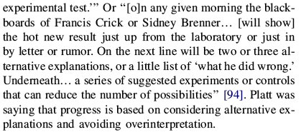
Ask ‘what might be wrong’
John Platt said this is the reason “why...some fields advance faster than others.” (Strong inference. Science 1964;146:347)

Slide 20
Clinical proteomics: Lessons
a. Problem
b. Causes
c. Lessons

Slide 21
Threats to validity of study design
1. Chance
Does chance explain ‘discrimination’?
2. Bias
Does bias explain ‘discrimination’?
•’discrimination’ means results differ in compared groups
i.e. Results look ‘positive’
•’bias’ means spurious systematic difference;
i.e., ‘Discrimination’ is not ‘real’ (example)
Ransohoff. Nat Rev Cancer 2005;5:142-9

Slide 22
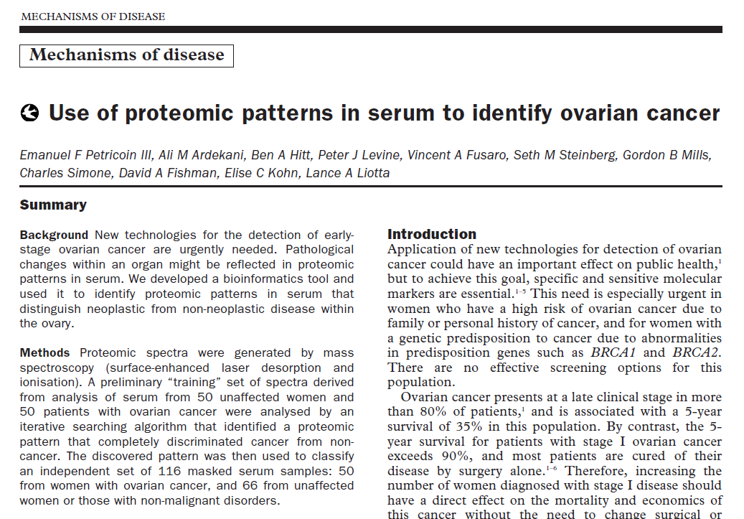
Problem: Bias – Example 1
Lancet 2002; 359: 572-577

Slide 23
Bias may be misinterpreted as ‘discrimination’
Claim
  ~100% sensitivity, specificity for ovarian cancer
Problem: Compared groups: different, not due to cancer
  Mass spectrometry measurements done on different days in cancer specimens vs controls
  Spectrometer drifts over time; ‘signal’ or ‘discrimination’ is hardwired into results.
(Baggerly. Bioinformatics 2004; JNCI 2005)

Slide 24
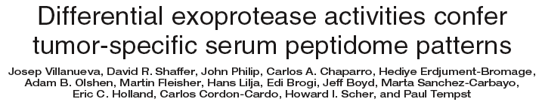
Problem: Bias – Example 2
J Clin Invest 2006;116:271
Results: Peptide patterns are
~100% sensitive, specific for prostate cancer.

Slide 25
Bias may be misinterpreted as ‘discrimination’
Compared groups are different:
•Cancer: mean age 67 y.o.; 100% men

Slide 26
Bias may be misinterpreted as ‘discrimination’
Compared groups are different:
•Cancer: mean age 67 y.o.; 100% men
•Control: mean age 35 y.o.; 58% women
tell M story

Slide 27
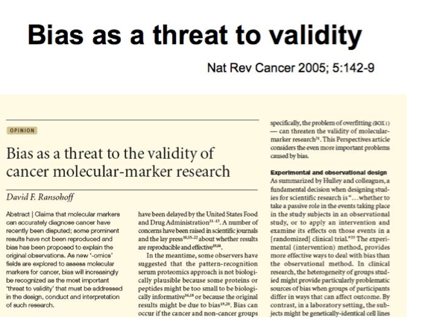
JCI paper said ‘we dealt with bias’, and cited:

Slide 28
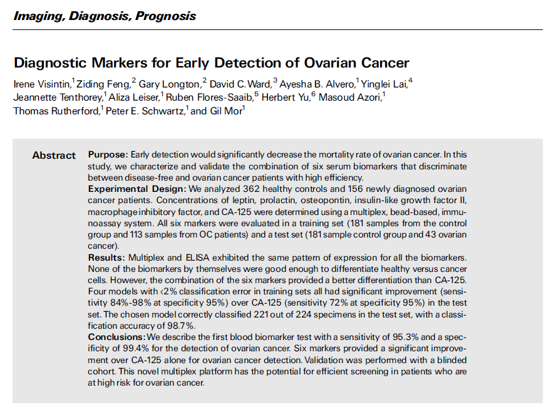
Problem: Bias – Example 3
Clin Cancer Res 2008;14:1065

Slide 29
Bias may be misinterpreted as ‘discrimination’
Compared groups are different:
•Cancer: from ‘high-risk clinic’ (with masses)
•Control: from screening clinic
Markers include ‘stress’ proteins that could differ in compared groups. Bias may or may not affect results, but possibility should moderate conclusions.

Slide 30
Bias may be misinterpreted as ‘discrimination’
Conclusions were not moderated (Feb/Mar 08)
-in research report
-in press release (Yale)
-in interviews (ProteomeMonitor)
LabCorp marketed test (spring 08)
FDA intervention (summer 08) (3 NYT stories)

Slide 31
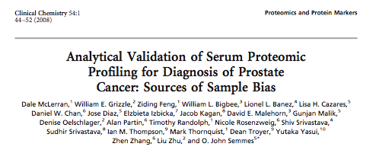
Bias – Example #4

Slide 32
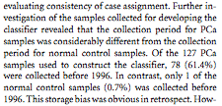
Source of bias: specimen collection

Slide 33
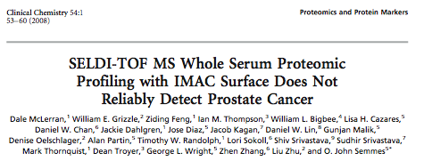
But in ‘validation’ the assay didn’t work.
“The resulting new classifier failed to separate patients with prostate cancer from biopsy-negative controls….”
“We conclude that the results from our previous [discovery] studies… likely had biases in sample selection that upon removal, as in the present study, resulted in inability of the technique to discriminate cancer from noncancer cases.”

Slide 34
EDRN program of discovery: Prostate Cancer
(NCI’s Early Detection Research Network - EDRN)
One assay reached ‘validation’ phase,
but assay wasn’t valid.

Slide 35
Many sources of bias
in study of diagnostic test, prognosis, or response to therapy
Examples #2,#3,#4
‘baseline inequality’
Example #1
Specimens
received in lab
Cancer
Control
Discipline:
(clinical) study design;
clinical epidemiology
Discipline:
laboratory science

Slide 36
If discovery is weak, subsequent work is doomed
Problem:
If design is wrong (specimens on L of Red Line biased), then ‘validation’ will show discovery didn’t work.
Lesson:
•Improve ‘discovery’: Use ‘strongly-unbiased’ specimens.
‘Turn conventional wisdom on its head’ (re ‘when’ to use precious specimens).
•Studies do not need to be ‘perfect,’ but no fatal flaw, in discovery too.

Slide 37
Bias is the challenge in observational research
Bias is not ‘icing on the cake’; it is the cake.
Bias is a large topic, difficult:
• multiple biases; require different methods to address
(e.g., randomization, blinding, uniform handling, etc)
• some methods not available in observational research
• some biases may be impossible to identify
• even ONE bias may be fatal
The ‘process’ to deal with bias is routinely ignored by authors, reviewers, editors in ‘omics’ research.

Slide 38
Bias is so serious that results are guilty (of bias) until proven innocent.
Innocence is proven by (innocence re Left of Red Line)
Doing process
• design - to avoid bias
• conduct - to measure if bias occurred
• interpretation - to determine if important
Reporting process
Methods, Results, Discussion
(Bias as a threat to the validity of cancer molecular-marker research. Ransohoff. Nat Rev Cancer 2005;5:142-9)

Slide 39
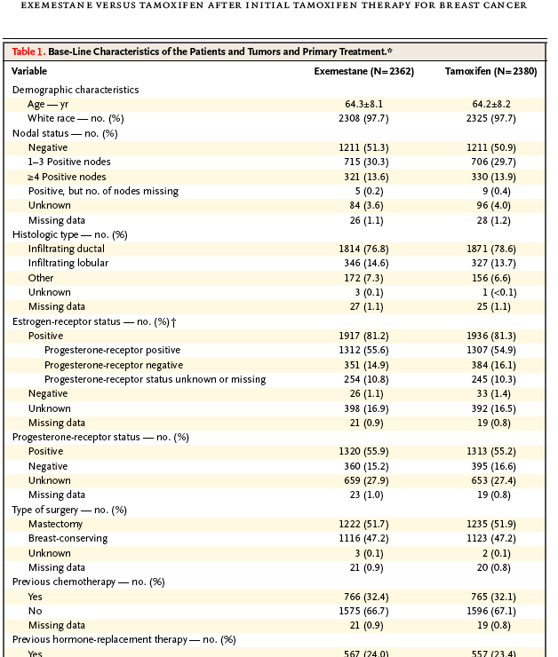
Bias of ‘baseline inequality’: process to address in experiment (RCT) -- Report ‘results of randomization’, in ‘Table 1’

Slide 40
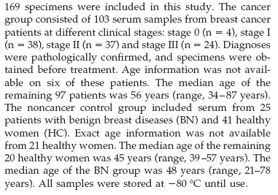
Bias of ‘baseline inequality’: process to address in typical ‘-omics’ study

Slide 41
Bias of ‘baseline inequality’: process to address in typical ‘-omics’ study
OK all were ‘stored at minus 80 degrees’.
That’s nice. But what about everything else that might be a source of systematic difference:
•#freeze/thaw
•storage duration
•source of patients
•ETC.
i.e. Need to describe/consider any details that might account for observed differences: “[I]f you know anything at all wrong, or possibly wrong--to explain it.”

Slide 42
To avoid bias, understand:
Specimens = product of a ‘study’
If specimens (e.g. serum, plasma) in ‘discovery’ study do not have ‘baseline equality’ (i.e. if bias hard-wired in), then ‘discrimination’ will be spurious... and not reproducible in ‘validation.’ I.e., GIGO.
The rate-limiting step in biomarker research is limited availability of ‘strongly unbiased’ specimens for discovery (and for validation).

Slide 43
‘Work’ of Table 1 is critical, even if limited
•Table 1 does not actually avoid problems of bias.
•Only reports “if bias happened” (compared groups unequal)
•Only STUDY DESIGN avoids bias (e.g. randomization). Reporting only shows if it happened.

Slide 44
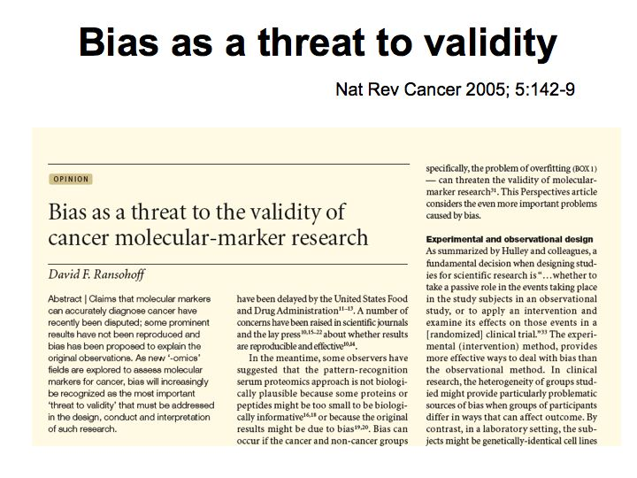

Slide 45
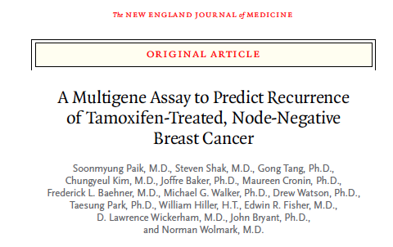
N Engl J Med 2004;351:2817-26.
Some studies avoid bias,
provide ‘reliable’ result:
RNA expression/BrCa prediction

Slide 46
Some studies avoid bias, provide ‘reliable’ result:
RNA expression/BrCa prediction
Purpose: ‘validate’ gene expr. signature (N=17) to predict BrCa prognosis; identify low-risk group (no adjuvant rx)
Method:
-signature was derived from literature (i.e. hypothesis)
-signature ‘tested’ in placebo arm of NSABP RCT
-technology advance: measure RNA expression
in FFPE; allows use of banked BrCa tissue
Result: good predictor
Lesson:
-role of design (to avoid bias)
-role of team with appropriate expertise and focus
-role of technology advance

Slide 47
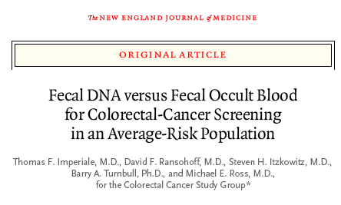
Some studies avoid bias, provide ‘reliable’ result:
Fecal DNA/CRC screening
NEJM 2004;351;2704-14
Disclosure: DFR paid consultant to Exact Sci ≤2002

Slide 48
Some studies avoid bias, provide ‘reliable’ result:
Fecal DNA/CRC screening
Purpose: learn whether DNA mutations in CRC can be found in stool, used for CRC screening
Method:
-biological advance: mutations/markers (Vogelstein)
-mutation panel tested in ‘prospective’ study
-technological advance: DNA extraction/purification
Result: fair sensitivity/specificity
Lesson:
-role of design (to avoid bias)
-role of team with appropriate expertise and focus
-role of technology advance

Slide 49
Some studies avoid bias, provide ‘reliable’ result:
‘Lessons’ from 2 examples:
-role of design (to avoid bias)
-role of team with appropriate expertise and focus
-role of technology advance
Why efforts succeeded (~useful marker, reliable result)
a. ‘Focused’ from start, on clinical use/decision for which a marker – with specific test characteristics - was needed.
b. Group ‘worked backwards’ to develop/discover marker.
c. ‘Study design’ was taken very seriously, to get reliable answer.

Slide 50
Clinical proteomics: Problems, lessons
a. Problem
b. Causes
c. Lessons (from a long list)
•Culture Clash
•Organization
•Other

Slide 51
Culture clash
Definition:
Methods (rules of evidence) differ in different fields
•Basic science: experimental method (strong)
•Clinical science: observational method (weak)
Importance:
•Study design flaws may be fatal in ‘translational’
research that uses observational methods
Solution:
•’Cross-talk’ (basic/clinial) is necessary... but gulf is big. What is right way to structure and do ‘cross-talk’
•One way: You train in both.

Slide 52
Other
•role of journals
•role of FDA
•is system self-correcting
•motivation of investigators
•’tone’, character of science (in meetings, journals)
-Discuss ‘alternate explanation’, ‘disprove’
-Challenge each other?
Watson/Crick vs Linus Pauling; vs each other
-Role of ‘negative results’

Slide 53
Challenges and Opportunities in Translational ‘-omics’ Research
Challenges
A challenge of ‘translational research’- that uses lab/basic methods and clinical epidemiology (especially observational epidemiology) methods: culture clash.
Opportunities
People trained in both methods can manage clash.
Example today
Proteomics for cancer diagnosis - Lessons from the last 10 years. (presented 2 wks ago in Cambridge UK, at Wellcome Trust)

Slide 54
Acknowledgements
National Cancer Institute
Division of Cancer Prevention
•Biometry Research Group
•EDRN- Early Detection Research Network
•Early Detection Research Group (PLCO)
CPTAC- Clinical Proteomic Technology Assessment
for Cancer

Slide 56
Lessons:
Two studies that avoided culture clash
a. Problem (clinical; laboratory)
b. Method, Result
c. Lesson (for conducting ‘translational’ research)

Slide 57
RNA expression to predict prognosis of ER+/node-negative BrCA

Slide 58
RNA expression to predict prognosis of ER+/node-negative BrCA
a. Problem (clinical; laboratory)
b. Method, Result
c. Lesson (for conducting ‘translational’ research)

Slide 59
RNA expression to predict prognosis of ER+/node-negative BrCA
Problem
•Among persons with ER+/node-negative BrCa, is there a low-risk (for recurrence) subgroup, that does not need adjuvant therapy?

Slide 60
RNA expression to predict prognosis of ER+/node-negative BrCA
Method
•identify (from literature/other) candidate gene expr. signature (N=17 genes) to predict BrCa prognosis
•’validate’ in placebo arm of NSABP RC
•technological advance (measure RNA levels in FFPE, instead of fresh-frozen) made it possible to use banked specimens from RCT placebo arm, solving a major challenge of ‘study design’.
Result
•good predictor

Slide 61
RNA expression to predict prognosis of ER+/node-negative BrCA
Lesson – Role of:
•team with appropriate expertise, focus (avoid cult. clash)
-what leaders; what experience
•clincal focus/question from start (work backwards from)
-what question; why; what answer is necessary
to affect clinical decision
•study design (to avoid bias)
•technology advance made possible use of banked specimens, collected with strong study design
Each step above was deliberate, explicit, necessary.

Slide 62
Fecal DNA to detect early CRC in screening
NEJM 2004;351;2704-14
Disclosure: DFR paid consultant to Exact Sci ≤2002

Slide 63
Fecal DNA to detect early CRC in screening
Problem
Can DNA mutations of CRC in stool be used for CRC screening?

Slide 64
Fecal DNA to detect early CRC in screening
Method
•biological advance: mutations/markers (Vogelstein)
•mutation panel tested in ‘prospective’ study that avoids bias
•technological advance: DNA extraction/purification
Result
•fair sensitivity/specificity (at least study was reliable)

Slide 65
Fecal DNA to detect early CRC in screening
Lesson – Role of:
•study design (to avoid bias)
•team with appropriate expertise and focus
•technology advance
Comment:
When clinical goal changed during study - from screeing to triage – it had impact on ‘desired test characteristics’ and on ‘technology’: goal became very high high sensitivity, modest specificity. Managing this required ‘communication’ between basic and clinical research cultures.

Slide 66
‘Lessons’ from 2 examples – different roles of:
•study design (to avoid bias, provide reliable result); taken seriously from start
•team with appropriate expertise and focus
•technology advance
•focus, from start, on clinical use, clinical decision
-determines test characteristics needed
-required woking ‘backwards’ to develop/discover marker

Slide 67
Next: Your experiences/challenges
Do you have:
-experiences/lessons, to help others
-challenges/problems, that others can help solve
Brief lessons/problems... or long ones... are welcome!

